Slide 1
Lesson Overview
Stop and think- 2 min
Evidence discussion (discussion of Stop & Think)- 5 min --discuss why evidence is important, how it helps us learn and what to do if evidence contradicts model.
Update model on MEME and link to evidence- 15min.
Evidence discussion- 5min if there are decomposers in the simulation does this mean there are decomposers in the pond
Before you go- 3 mins.
Total time- 30 mins

Slide 2
LESSON 1 - DAY 2
Notes:
Day 2 Outline
Goals-
- Decomposers use up air when eating dead matter (in this case dead algae)
- Decomposers grow and multiply
- Decomposers breathe air just like we do (dissolved air in water decreases)
Epistemic goals-
- Simulations can be used to test hypotheses.
- Evidence and simulations can be used together to develop and test hypotheses.
- If simulations do not fit the empirical evidence, their assumptions can be changed.
Carefully aligning evidence & simulations with models makes models better.
Materials
Computers- MEME and simulation
Student packet

Slide 3
STOP & THINK!
Grab a handout and put your name and information on the top of the first page.
Complete the STOP & THINK! question on the first page.
Why is evidence important when we are trying to figure things out in science?
Notes:
Instructions-
Give students each a handout, fill out their info and complete the Stop and Think which asks why evidence is important. Don’t discuss here, the discussion opens up on the next slide.

Slide 4


Evidence: Discussion
Why is evidence important?
How does it help us learn?
What do we do if a piece of evidence goes against a model?
Notes:
Instructions 5min Keep this brief, we just want to know what they think at this point
Open up a class discussion on the three questions. You can draw on their answers to the stop & think to launch the discussion.
Rationale
The aim of the discussion is to see how students are thinking about evidence. Some questions or ideas to think about are listed below but these are not exactly what students NEED to be thinking at this time. Let them discuss, debate and figure out what they think. There isn’t a right answer.
Things to consider-
1. Do they see evidence as something important and useful? Can evidence inform our decisions?
2. Evidence helps us by giving us information or facts that we can use to tell that’s going on in the pond/what is happening in a phenomena. Evidence tells us what to believe or what is true.
3. The debate here will be about whether we need to change a model (this will happen in this curriculum). Another way this could go is that the evidence might be wrong but this is beyond the scope of what we want them to think. If they do discuss this, just let them go with it, there isn’t a right or a wrong or a need to shy away from it. We would like them to think that they need to change their model but lets wait for one of the kids to say it.
Later, students will learn how to link evidence to their model so this step will help them to understand why they need to do that.

Slide 5
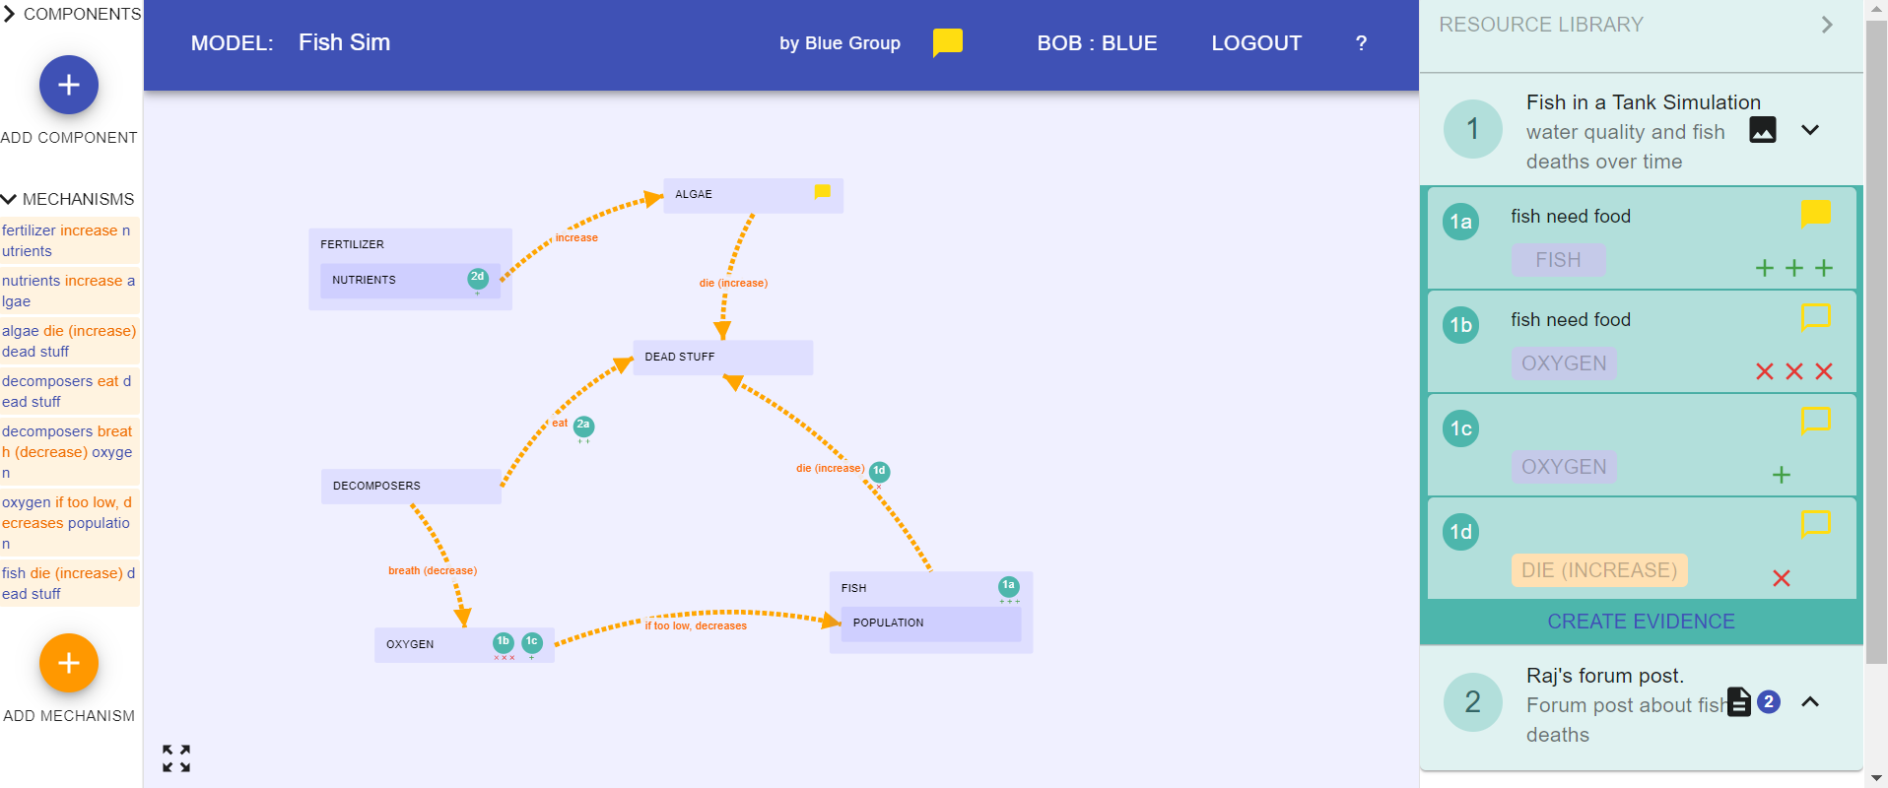





MEME: Update Model
Update model on MEME to include what we learned from ALL the evidence up to now.
Make sure you show how your model is supported by evidence (link the evidence).
Make sure your model meets the class criteria.
Dead Fish
Notes:
Instruction
Explain that we need to update our models based on the evidence we studied yesterday. Briefly ask students to turn and talk about what evidence we want to include on MEME and what else they might want to included. Have students share ideas. Again, there isn’t a right or wrong answer. Let students question and debate with each other. It’s a great opportunity for them to test out their ideas.
Since studying the evidence, we have learned that decomposers multiply and that they use up the dissolved air. We want to add these components and mechanisms to the model. They might also want to add things that were missing, such as the word microscopic, if they feel it was important. This was just an example, we can see what they come up with. Now we have learned that decomposers use up the dissolved air, and that more decomposers mean that more air gets used.
Materials
Hand out computers. Have class consensus model visible on show to remind students of what we previously constructed.

Slide 6
MEME: Link Evidence
On your handout answer the question, individually:
Why is it important to link evidence?
Notes:
Instruction
Tell students to individually answer the prompt. We are expecting responses such as: it strengthens the model, shows where we get the info from, allows us to see the info if we need to check a fact, makes facts stronger etc.
Please don’t guide them in any way, accept all answers.

Slide 7

Evidence Discussion
Do you agree or disagree?
We can see there are decomposers in the simulation, so this means there must be decomposers in the pond…
Notes:
Instructions
IF THERE IS TIME: Have a class discussion about whether seeing decomposers in the simulation means that there must be decomposers in the pond.

Slide 8
BEFORE YOU GO
Answer the BEFORE YOU GO question at the end of your handout.
We have worked with simulations in this lesson.
How do you know if what a simulation shows is really what happens in a pond?
Notes:
Instruction
Students will answer the Before You Go on the last page of the packet. This is an exploratory question, to see what they know about how simulations are created and what they represent. Some students might say the simulations do represent what happens and leave it at that. Other students might say they know because the sim was created to show a concept. Others might say we don’t know because it was created by someone. All answers are acceptable.
Collect packets at end of the lesson.

Slide 9
MEME Tutorial
Reminder

Slide 10
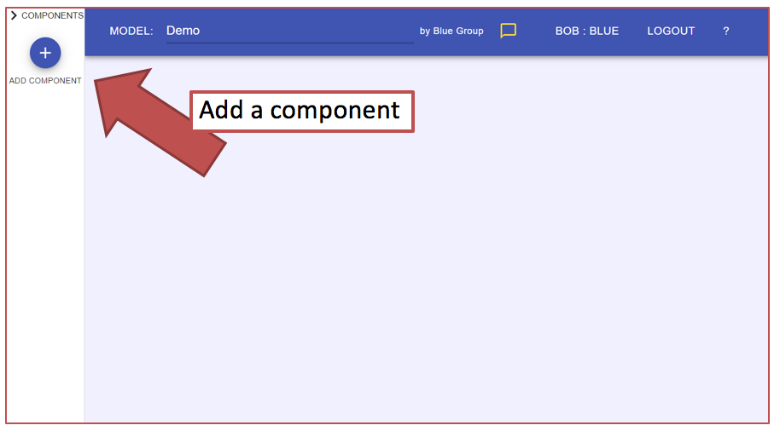
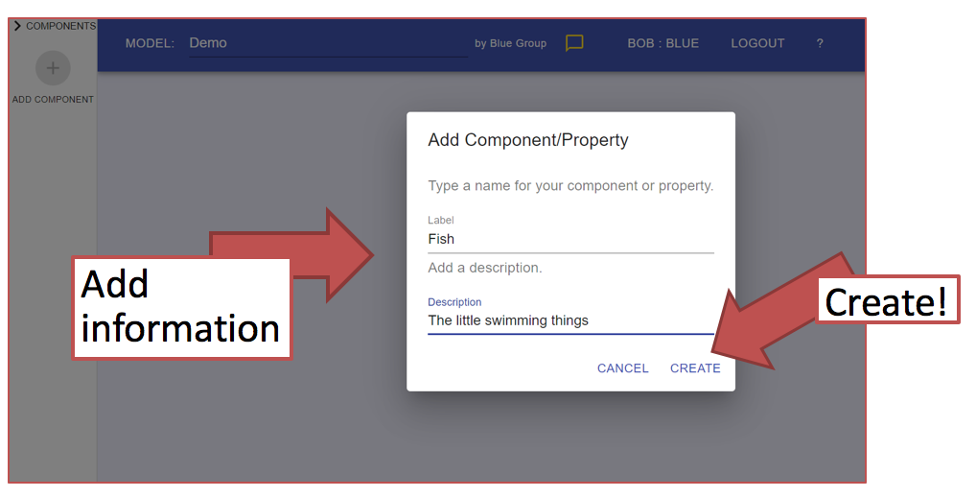
MEME: Review
To add a component click on the purple + button:
Type the name of component and click create:
Notes:
Instruction
Remind students how to add a component by clicking on the purple button and typing the name of the component. Here would be a good time to talk about describing components. For example, for decomposers they can add microscopic here as a detail.

Slide 11
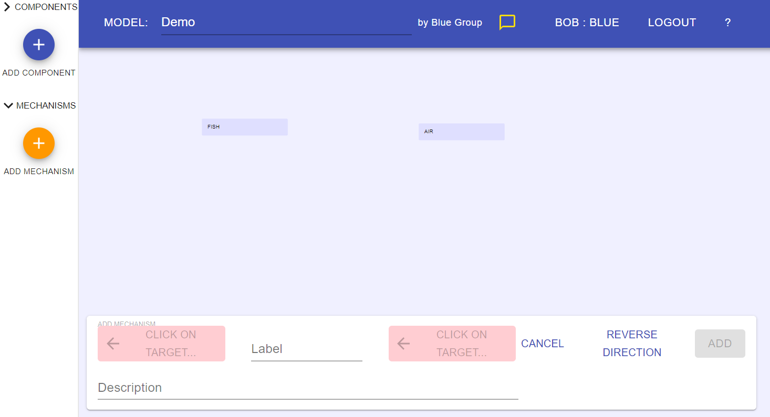
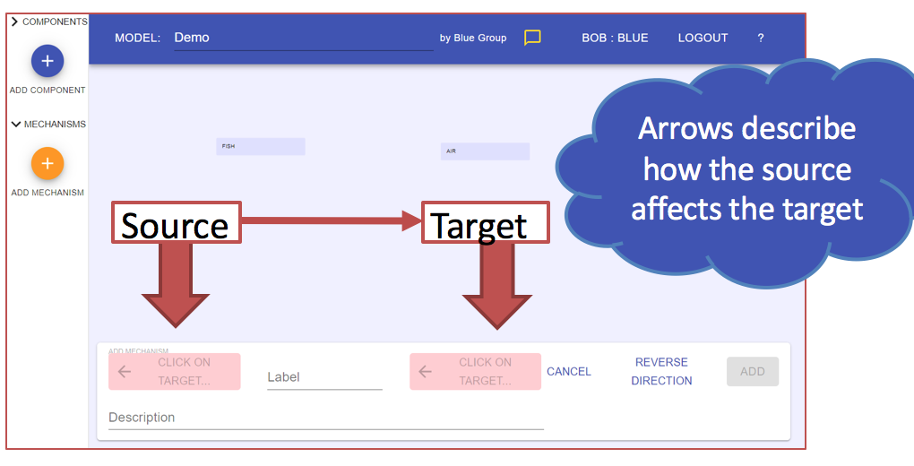
MEME: Review
To add a mechanism click on the orange + button:
Then select target (where mechanism going from and to) and label the mechanism.
Notes:
Instruction
To add a mechanism: click on the orange + button. Then type in target (where arrow going from) and to(where arrow going to) Add descriptor to the line/mechanism. Click ok.
Reminder- students can move components and mechanisms around by clicking and holding on the icon and moving it about. They can also delete it by clicking on the component or mechanism then clicking delete at the bottom of the page. They can also change one by clicking on the component or mechanism then clicking edit at the bottom of the page.

Slide 12
MEME: Link Evidence
Now, let’s look at how we can make our model stronger by linking evidence to the components and mechanisms.
See next slide for instructions...
Notes:
Instruction
Remind students that they can make their model stronger by linking it with evidence. This makes the model stronger by showing directly how it is supported and where that support comes from. Briefly remind students about how we talked about how evidence is important and helps us learn. This is one way we can directly use evidence to help us learn, by linking it to the model.
Things to consider- The students might have trouble following along step by step so make sure to do each step one at a time and make sure they are all with you. The rest of the team will be on hand to trouble shoot as we go through each step. Also, this step will make more sense to students if they are on board with why evidence is important, so recapping that point before linking the evidence will help them to see the purpose for this step.

Slide 13
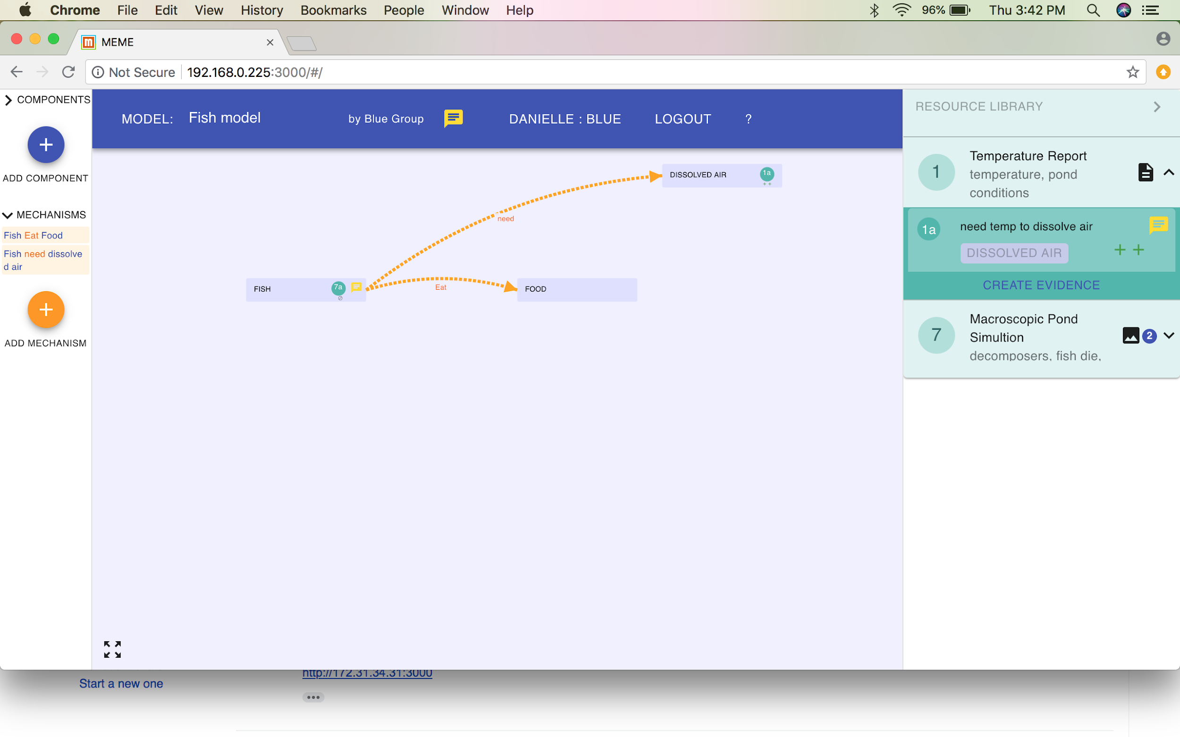
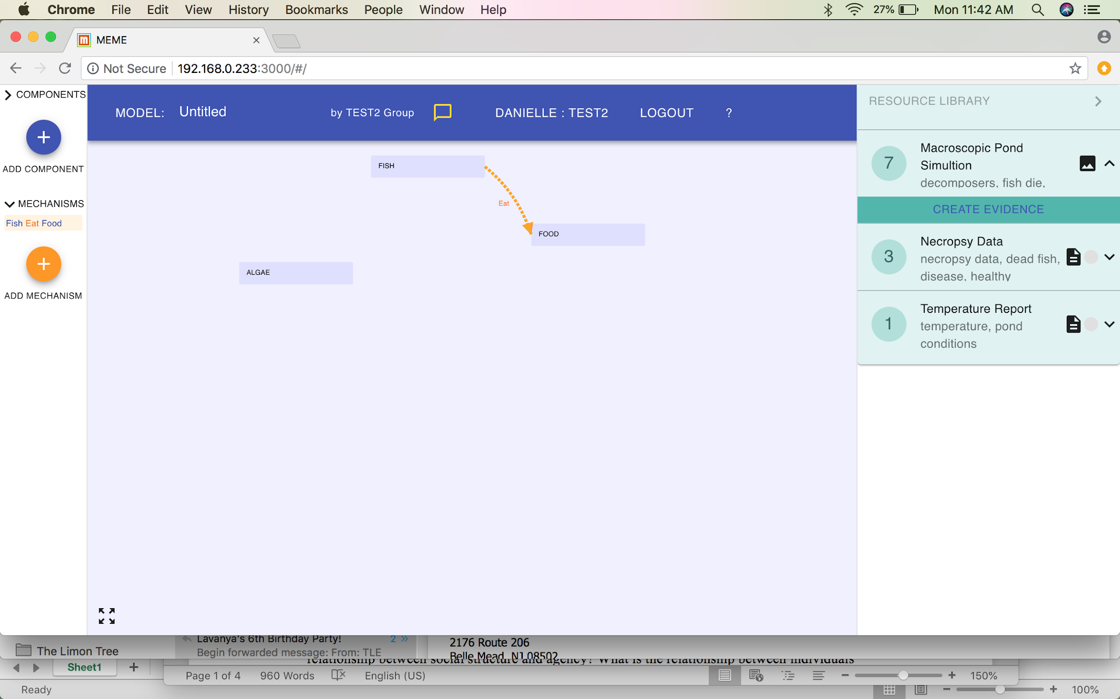
MEME: Link Evidence
Step 1: Click on the
resource
(green box) that you
want to add evidence
to
Step 2: Click on create evidence
Notes:
Instruction
Step 1- Identify the resource that they want to add evidence to. For example, they might want to add evidence to a piece of evidence they studied in stations yesterday or a simulation they worked with.
Step 2- click on “create evidence” in the dark green box that is below the green resource box.

Slide 14
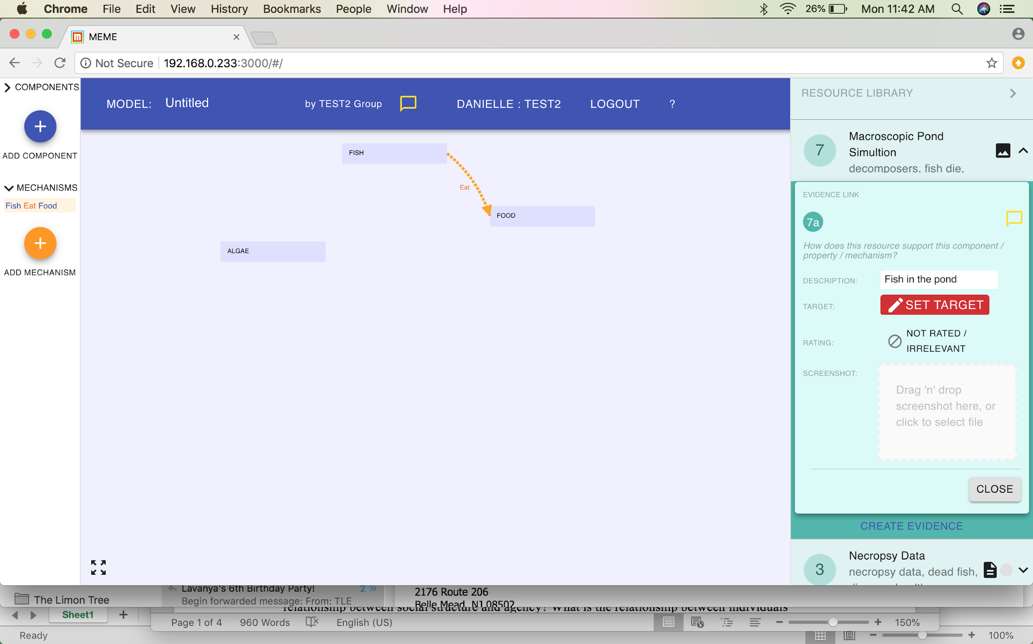
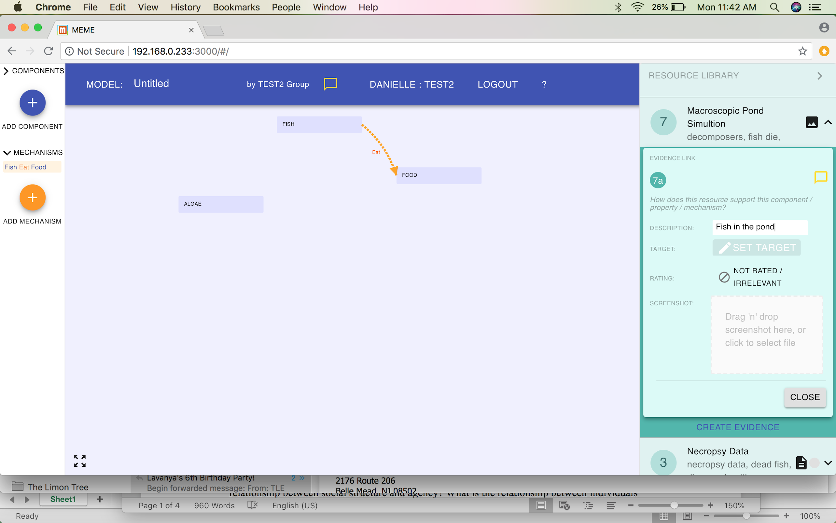
MEME: Link Evidence
Step 3: Name the
evidence. For
example, sim shows
fish in pond.
Step 4: Now we want to set target. Think: what does the evidence support? Click on “set target”
Notes:
Instruction
Now the screen looks like this. Step 3- Name the evidence. Remind students that it’s important to name the evidence in a way that tells then what the evidence is. If they name the evidence after football teams, they won’t remember which piece of evidence is which. They can name is something like “sim shows fish in pond.” This reminds them that this evidence shows that there are fish in the pond. Also, don’t make description too detailed or the name will be too long and they won’t be able to read it.
Step 4- Click on set target.This means they link the evidence to a specific piece of the model. They can link it to a component or mechanism. Talk through what an appropriate target would be. For example, do I want to put a piece of evidence proving that there are fish in the pond on the air component? No because they are two separate things and that piece of evidence is not connected to air. Therefore, students need to think through which piece of the model they are proving. Click on set target.

Slide 15
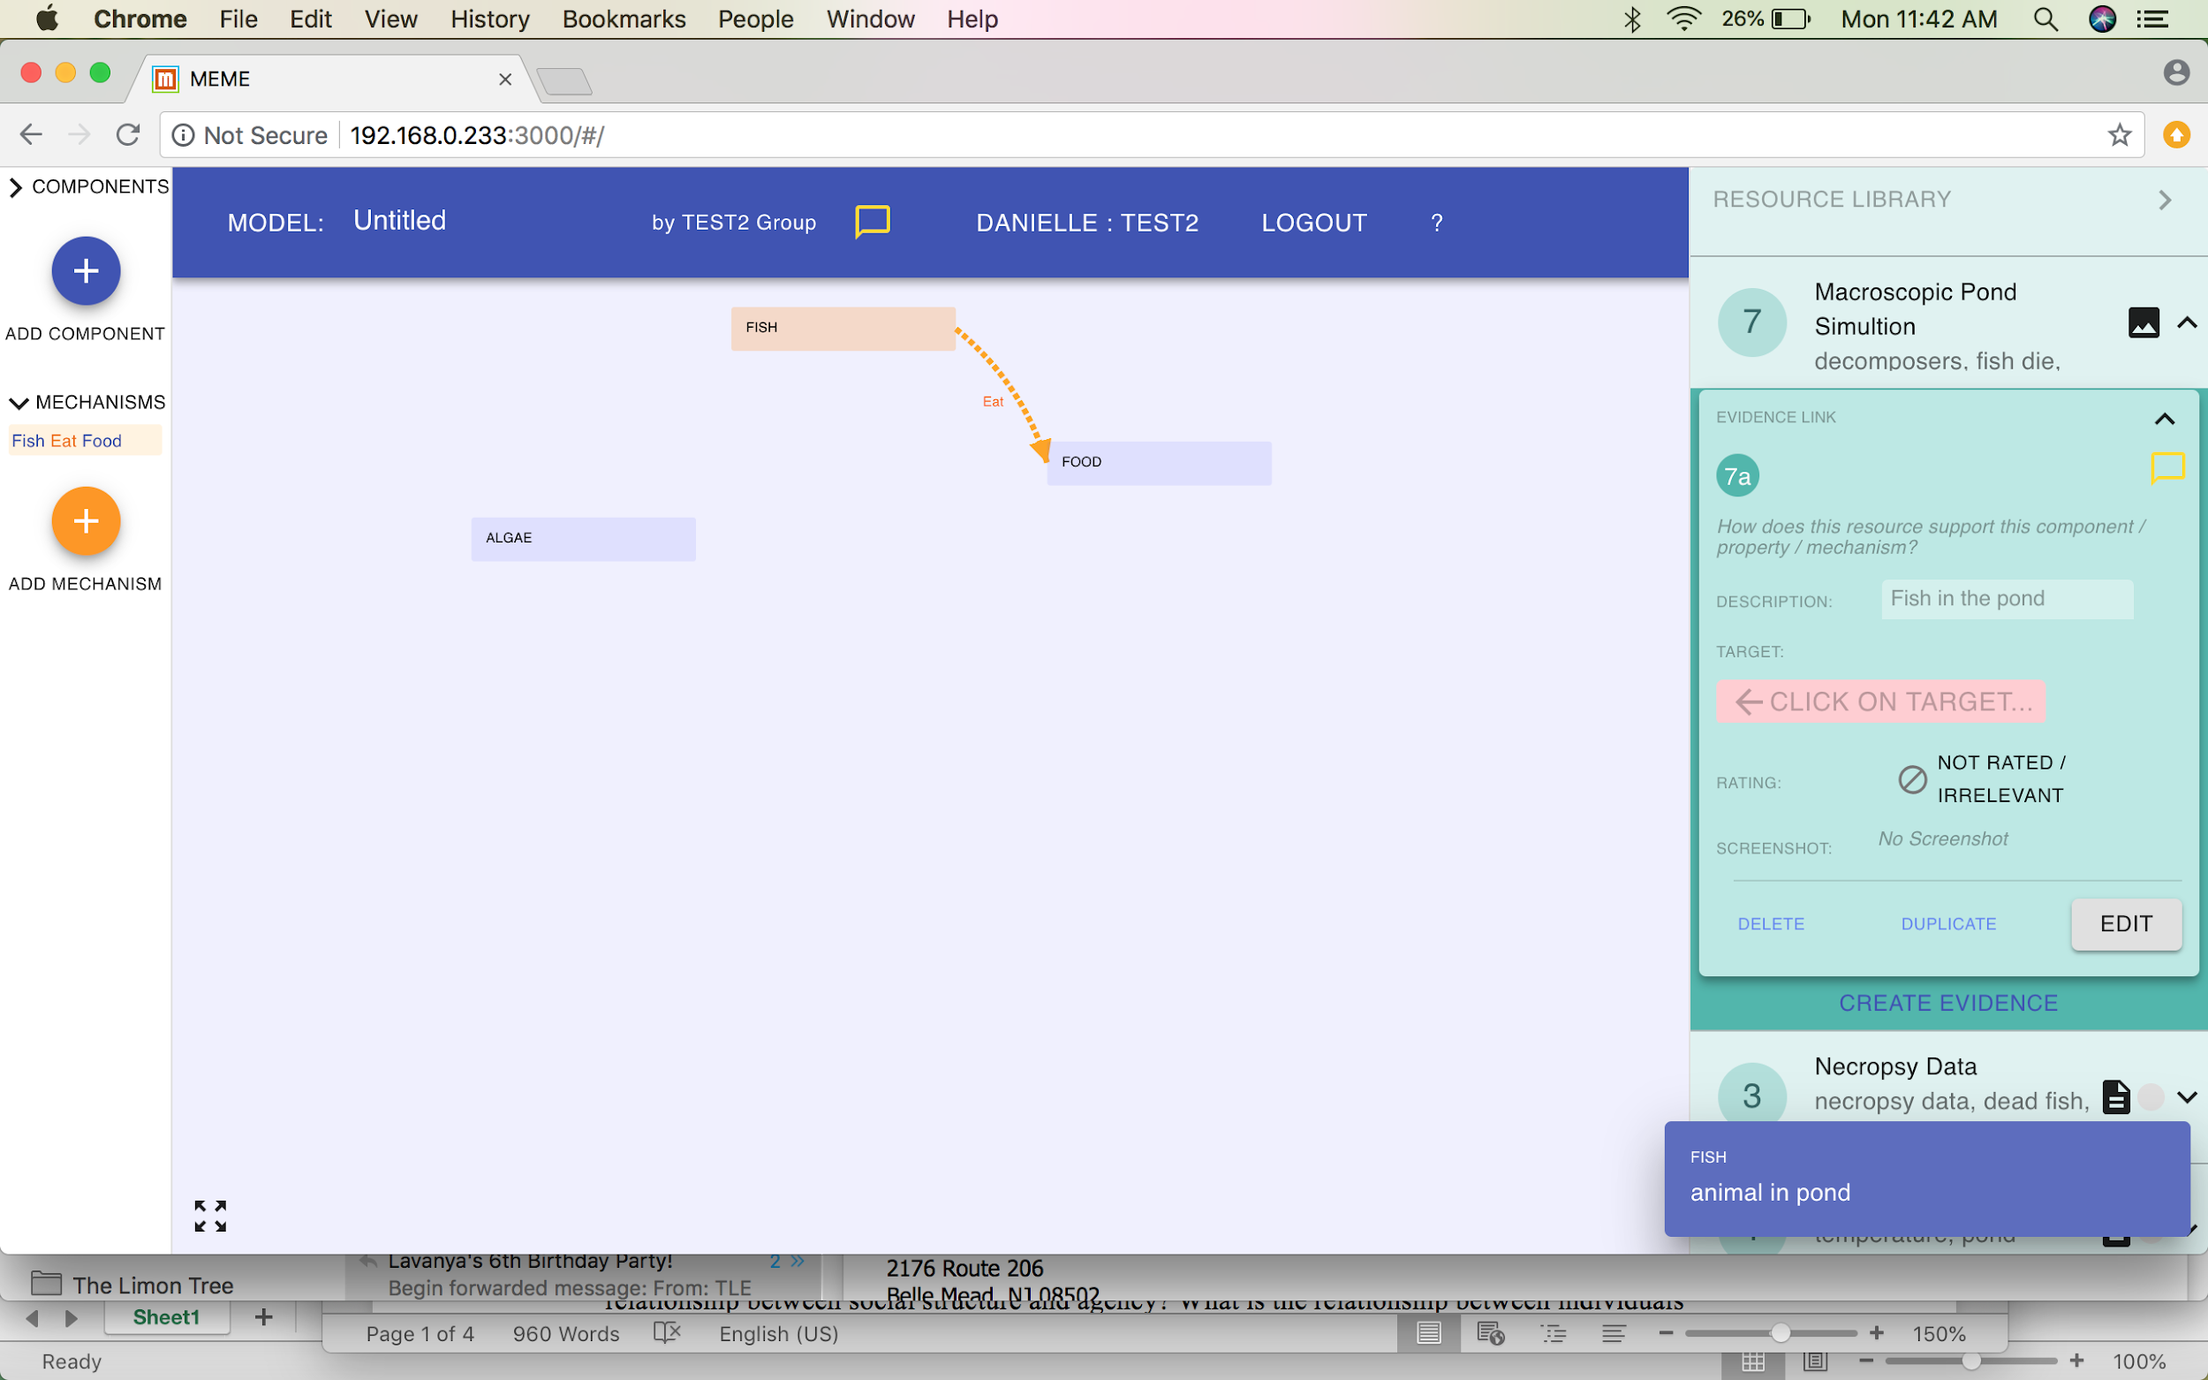
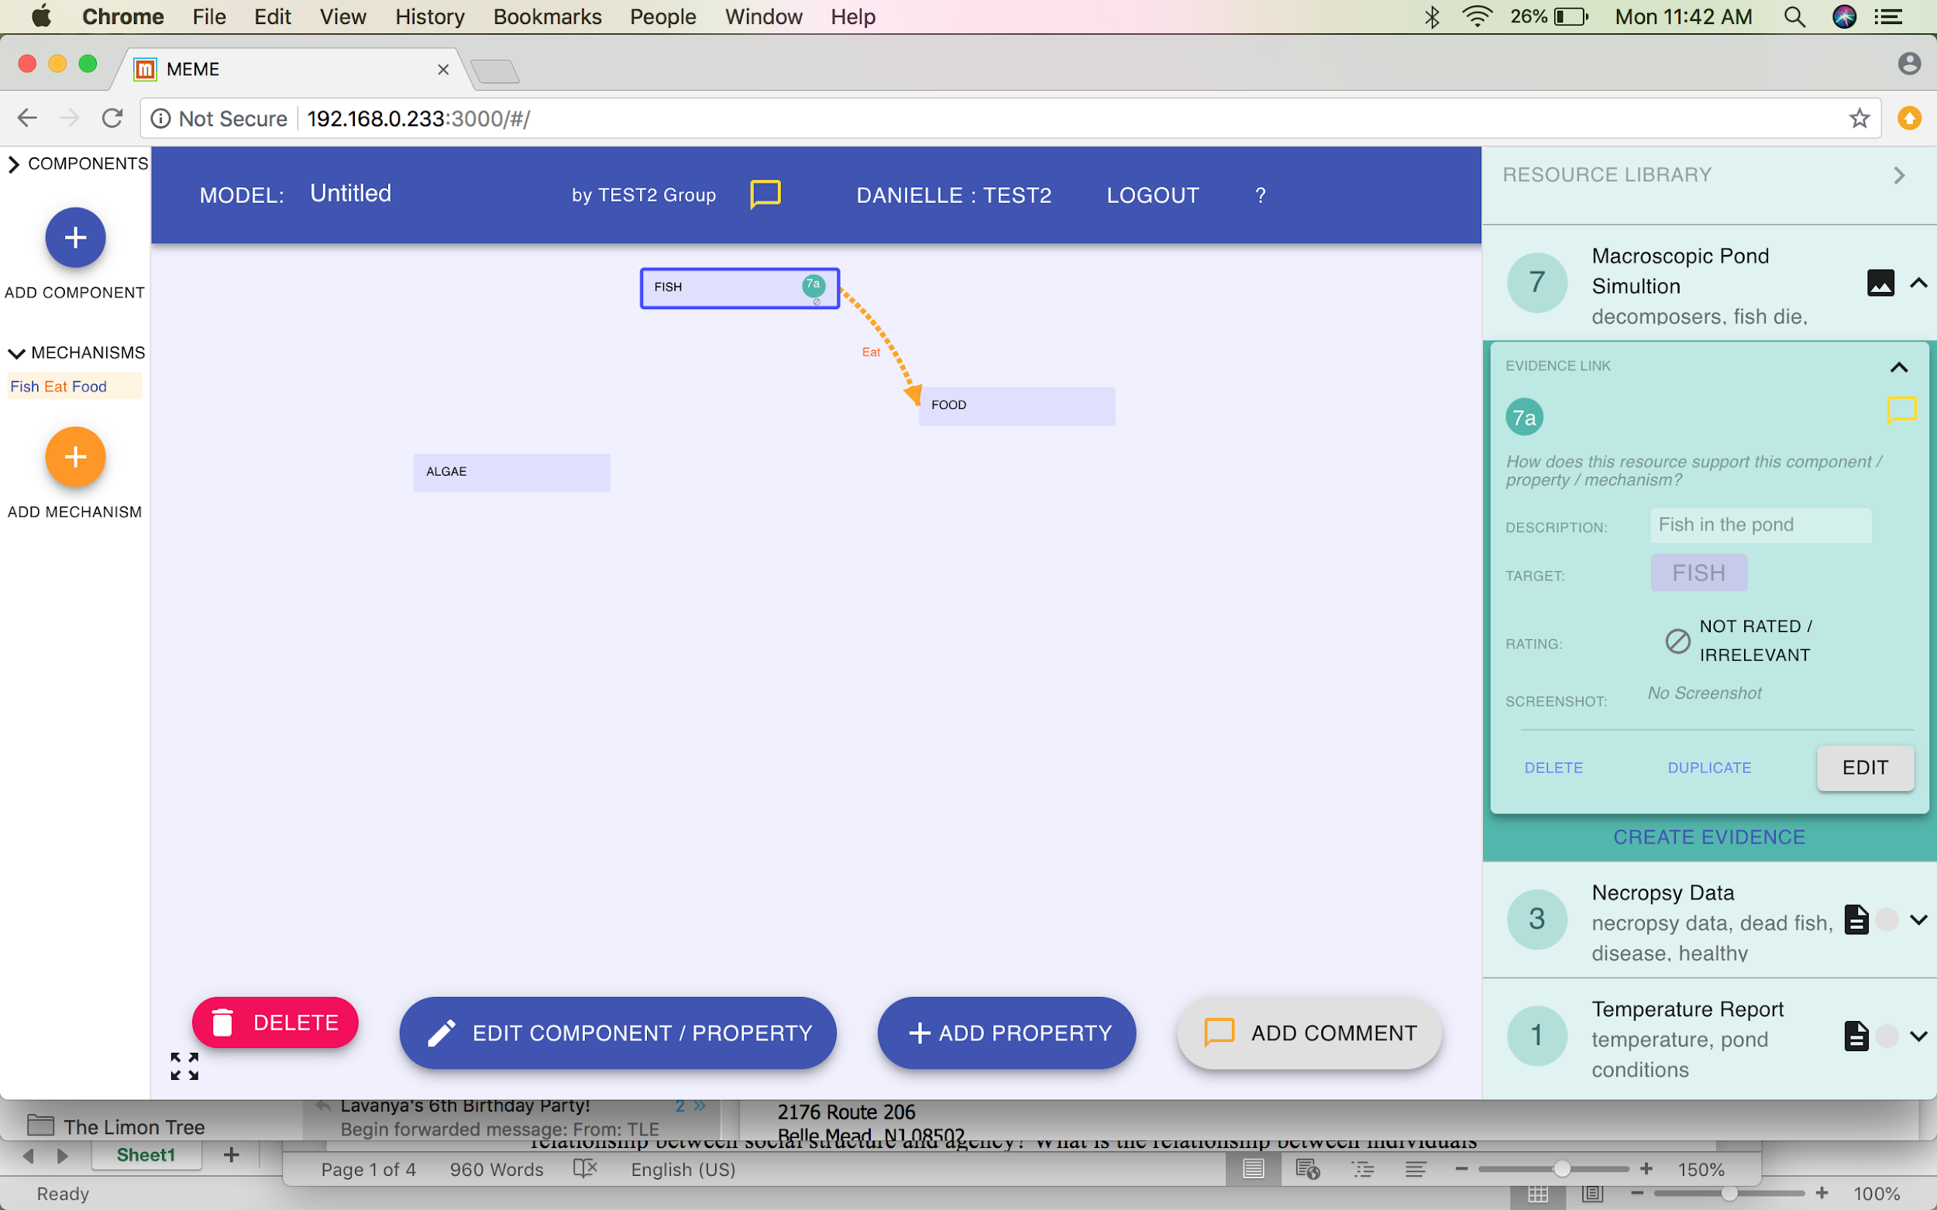
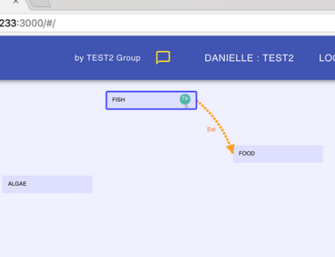
MEME: Link Evidence
Step 5: See the instruction
to “click on target”
Step 6: Select the target, which is a component or mechanism.
Now see the evidence number and
location in the green circle
Notes:
Instruction
Step 5- NOTICE how the “click on target” button is now showing in pink. This is telling students to select the target that they want. Remember, they want the target that the evidence directly relates to.
Step 6- click on the target. This is the piece of the model they want to support.
Step 7- this piece happens automatically. They will see a small green circle in the place where they put the evidence. Here, they can see that the evidence is on the fish component, therefore supporting that there are fish in the pond.
Explaining a bit more what this evidence link looks like- the evidence link (green circle) contains a number. The number means the order for which the evidence was input into MEME. If they click in the resource library, they will see the number next to the name of the evidence (which is why it’s important that the name describes what it is supposed to describe).
After these steps, they don’t need to do anything. The evidence automatically saves. They will think they need to click “ok” or something like that but they don’t. They can click the arrow up button on the top of the evidence box to minimize the evidence box.

